Slide 1

Movie Recommendation System
CSYE 7200: Big Data Using Scala
Prof. Robin Hillyard

Slide 2




Group 2
-the Scala developers team
Jiali Chen
Sukanya Aswini Dutta
Yaodong Chen
Zhengdong Xu

Slide 3
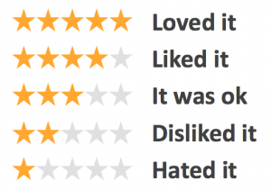
Use Case
User input
In this case, we assume the input will be one user id that already exists in the database.
System
The algorithm will return 10 movies recommended by the movie database to this specific user. This user has not seen these movies before. The rating is from high to low.
UI will take user id as input and return the recommendation.

Slide 4
Methodology
Content Based Filtering | Collaborative Filtering
Movie 1
Movie 2
Watched by both users
User
Movies watched by user
User 1
User 2
Similar movies
Similar users
Movies recommended to user
Movie 3
Watched by User 1 recommended to User 2

Slide 5
Methodology
Collaborative filter approach: We make predictions about the interests of a user by collecting preferences or taste information from many users (collaborating)
Spark MLlib library provides a collaborative filter implementation using Alternate Least Square (ALS)
Based on this recommendation system, we recommend movies to the user. And using the test data calculate the top 10 rating movies
Result: recommendation list for each user

Slide 6
Datasource
MovieLens website: https://grouplens.org/datasets/movielens/
27,000,000 ratings and 1,100,000 tag applications applied to 58,000 movies by 280,000 users
Includes tag genome data with 14 million relevance scores across 1,100 tags
Files:
ratings: userId, movieId, ratings, timestamp(Ignored)
movies: movieId, title, genres(Ignored)
Small dataset for the testing purposes
100,000 ratings, 9,000 movies, and 600 users
Large dataset: 27,000,000 ratings, 58,000 movies and 280,000 users
Full dataset will be applied for the final result

Slide 7
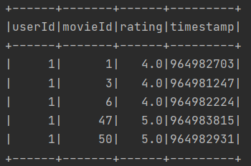
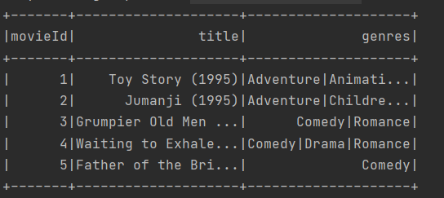
Data Preview
Rating dataset: ratings.csv
Movie information dataset: movies.csv

Slide 8
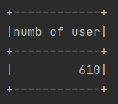
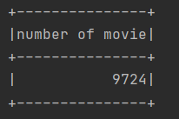
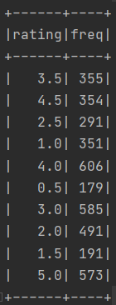
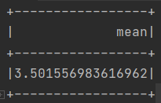
Data Exploration
Total number of users
Total number of movies
Frequency of each rating
Average rating

Slide 9
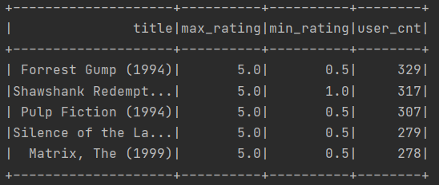
Data Exploration
Rating range and total number of rated users for each movie

Slide 10
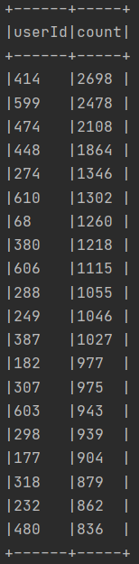
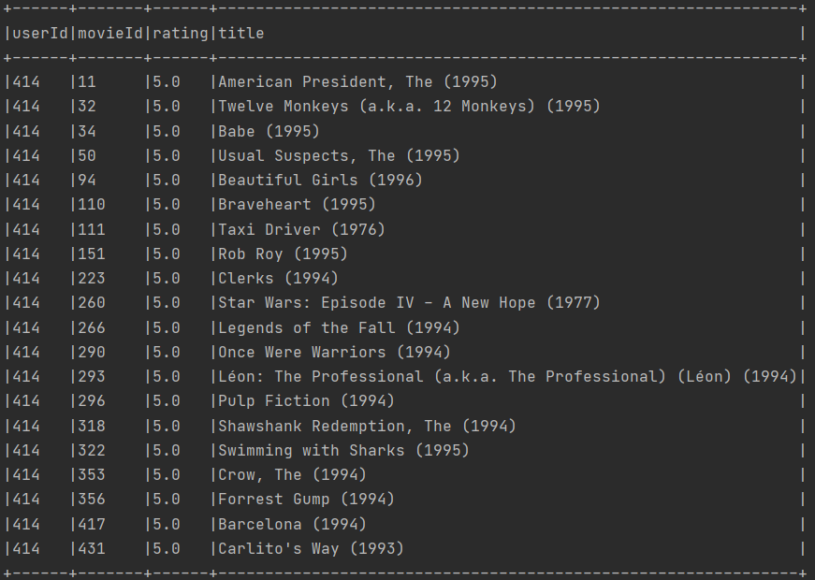
Data Exploration
Active users
User Profile Information

Slide 11
Data Modeling
Alternate Least Square Algorithm (ALS) is used in the context of recommendation.
80% training and 20% testing.
This algorithm predicts missing ratings for specific users and specific movies based on ratings for those movies from other users who gave similar ratings for other movies

Slide 12
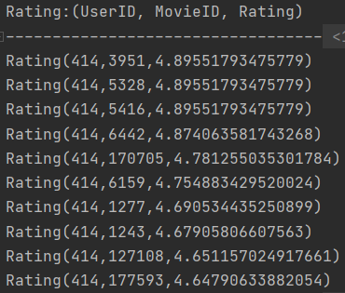
Making Predictions
Generate top 10 movie recommendation for a specific user:
For eg. user ID 414

Slide 13
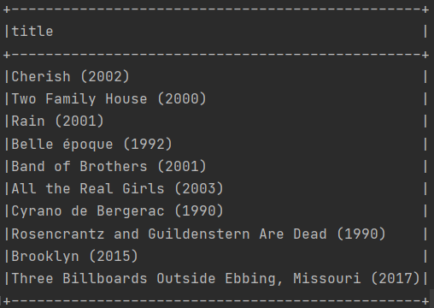
ALS Recommendation
Top 10 movie recommendation for user 414

Slide 14
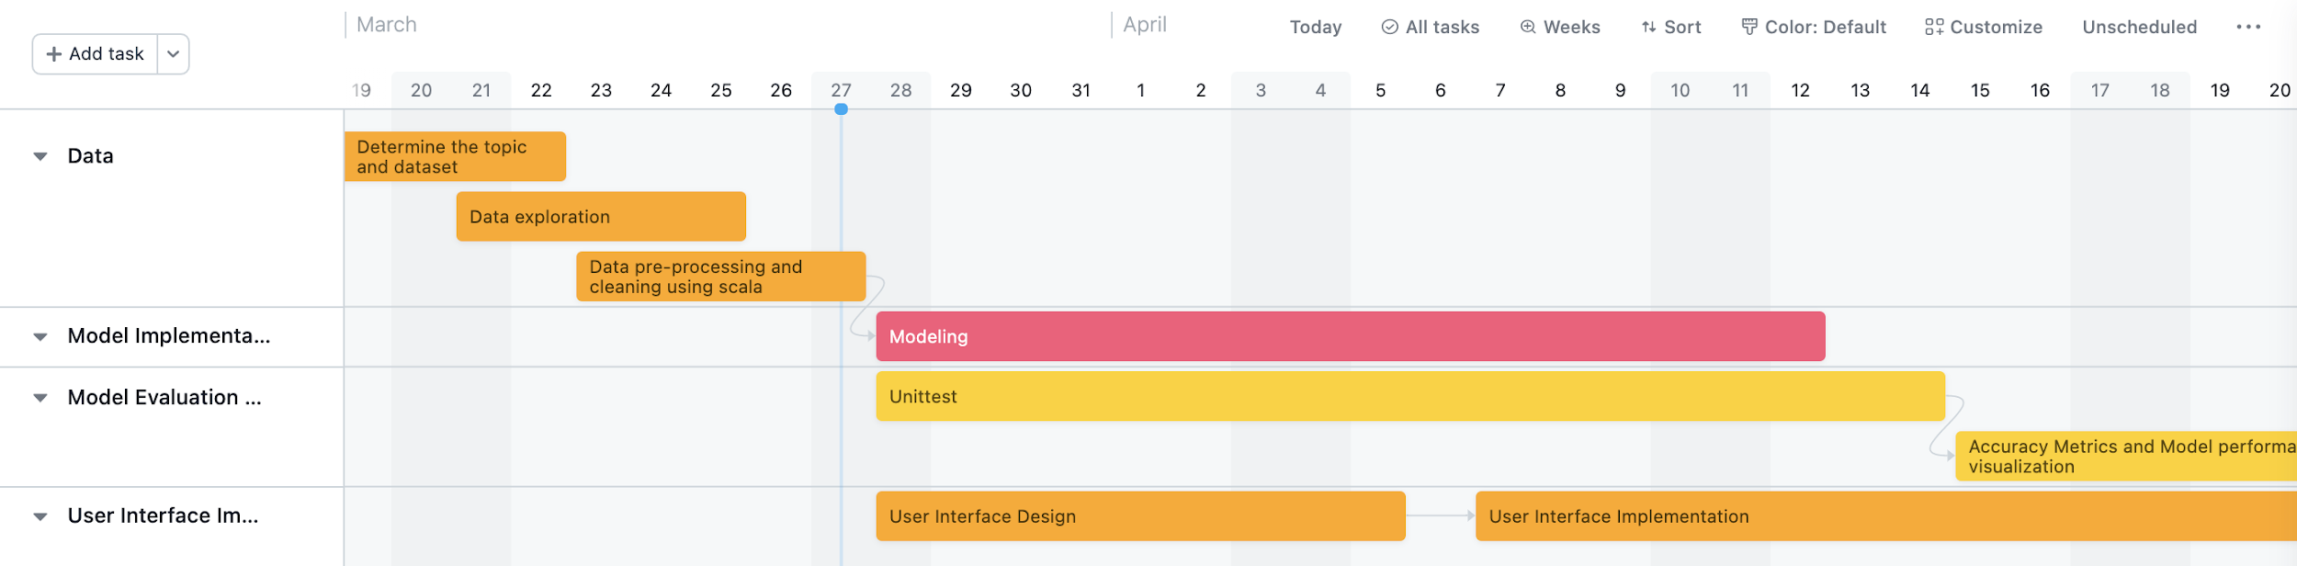
Milestones
Notes:
Arrow indicates dependency between every task

Slide 15
Programming language & Repo
Scala and SQL
Reading and parsing the dataset
Data pre-processing and cleansing
Modeling
Model evaluation
Unit-test
Accuracy metrics and model performance
UI Designed and Implemented using Play framework
Project GitHub Repository Link:
https://github.com/yaodchen/scala_project

Slide 16
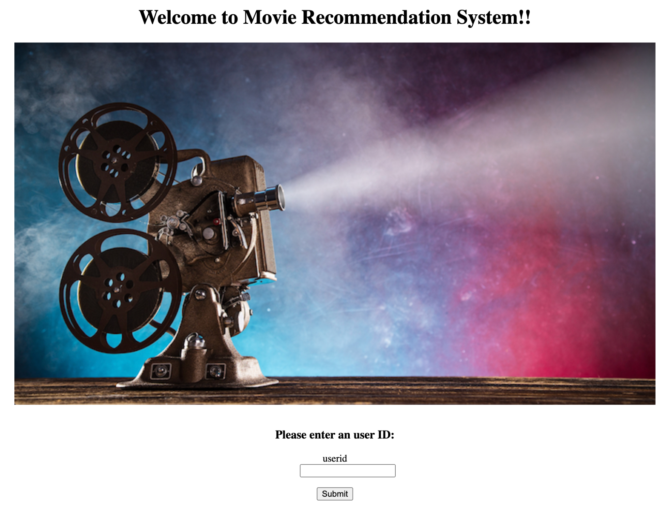
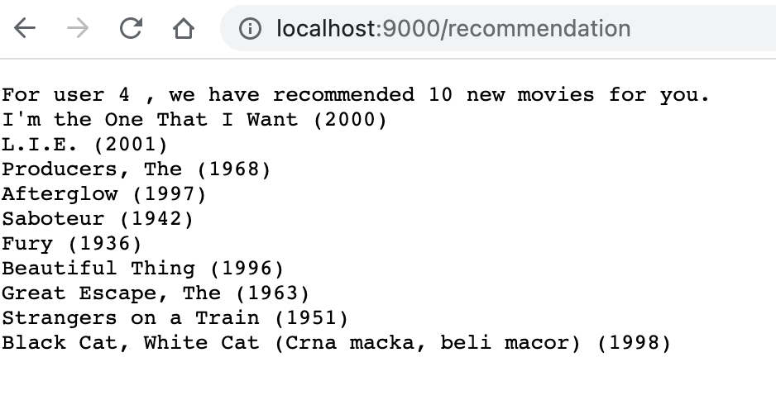
Our Movie recommendation UI 🎥

Slide 17
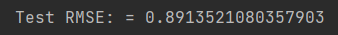
Acceptance criteria
Using testing data, evaluate recommendation model performance
Pass all unit test for final model testing, unit test will be written in 8 out of 10 movies in recommendation matches
Model running time for each recommendation iteration takes less than 10 seconds.
RMSE is used to evaluate the model and measure the difference between values predicted by a model and the values actually observed

Slide 18
Improvements
Movie genre could be an input to provide more precise result from the recommendation algorithm
New users should be added to the database accordingly
The performance of the preceding model could be increased more
However, so far, there’s no model tuning facility of our knowledge available for the MLlib-based ALS algorithm
Expect less running time

Slide 19
QnA
Thank You!

